Slide 1


Health Savings Accounts (HSA) Basics
Fall 2012

Slide 2
THE BASICS

Slide 3
HSA Requires Qualified Plan
HSA COMPONENTS
QHDHP
Low-Premium, High-Deductible Health Plan
THE INSURANCE PIECE
HSA
Health Savings Account
THE ACCOUNT USED TO FUND
THE DEDUCTIBLE—TAX-FREE
Insurance Company
HealthAmerica
Financial Custodian
HealthEquity
Notes:
3
There are two components to HSAs, first you must be on a qualified high deductible health plan which is your insurance. When you are enrolled in this insuracen the IRS allows you to have a health savings account. HealthEquity is the financial custodian.

Slide 4
What Makes a Q-Plan Different?
Every medical and pharmacy claim is subject to the deductible.
Copays and coinsurance do not come into play until after the deductible is met.
A(n) employee + dependents must meet the entire “family” deductible.
Eligible to be paired with a Health Savings Account.

Slide 5
What Is an HSA?
Savings account that you own and:
  Can use to pay for qualified medical expenses
  Earn interest on
  Can invest when a certain threshold is met
You and/or
Employer Contribute
Your HSA
Qualified
Medical
Expense

Slide 6

Am I Eligible?
To qualify for an HSA an individual:
Must be covered by a qualified high-deductible health plan (HDHP)
Must be 18 years or older
Cannot be enrolled in Medicare
Cannot be claimed as a dependent on someone else's tax return
Have no other health coverage except what is permitted by the IRS as other health coverage
Notes:
Take advantage of the HSA, determine who is eligible.

Slide 7



Contribute To Your HSA
The IRS allows you to make annual tax-free contributions to your HSA.
2013 Maximum HSA Contribution Limits
Single Insured
$3,250
Family Insured
$6,450
55+ Catch-Up Contribution
$1,000

Slide 8
WHY CHOOSE AN HSA?

Slide 9
Maximize Your Money
Save and keep your money
  Lower premiums, tax-free, long-term savings
  You own the account and the money stays with you
Grow your money
  Money rolls over year to year
Three tiers of tax-advantages
  Contributions aren’t taxed and reduce your annual
  taxable income
  Withdrawals are never taxed or penalized when used for qualified medical expenses; including Rx, dental, vision
  Earnings aren’t taxed

Slide 10
Maximize Your Options
Providers
Even if your doctor isn’t a network provider, you may use
your HSA to pay your bill
Protect your account and pocket book
Change jobs or retire; and keep your account and balance
Most HSA-qualified plans have maximum out-of-pocket limits
  Reach your limit, and expenses are fully covered
  Before you reach your limit, use your HSA balance to pay costs
  Cover spouse/dependent expenses, even if on another health plan
    Your spouse and dependents don’t need to be covered by your HDHP
    to use your HSA funds to pay their out-of-pocket medical expenses

Slide 11
HEALTHEQUITY ENROLLMENT

Slide 12


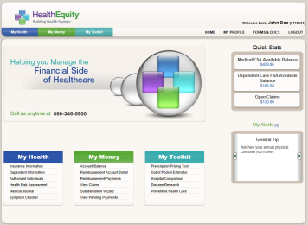
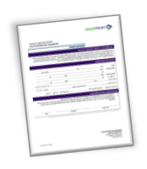


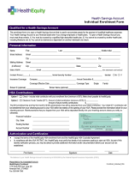
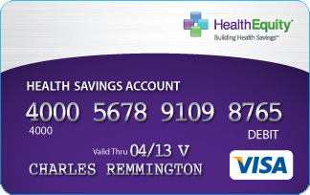
The Process
Open Enrollment Meetings and Communications
Account Screening
and Set Up
First Login to Web Portal
60–90 days prior
40 days prior
15–20 days prior
Plan Yr. Begins
Ongoing
HealthEquity
Receives Electronic Enrollment
Welcome Kit and Debit Card
Ongoing Education
01001010010110
Notes:
12
12
12

Slide 13
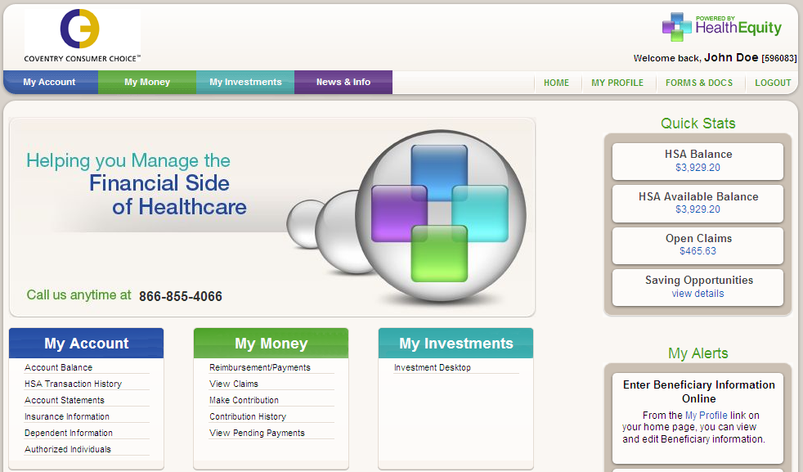
Member Portal www.myhealthequity.com

Slide 14
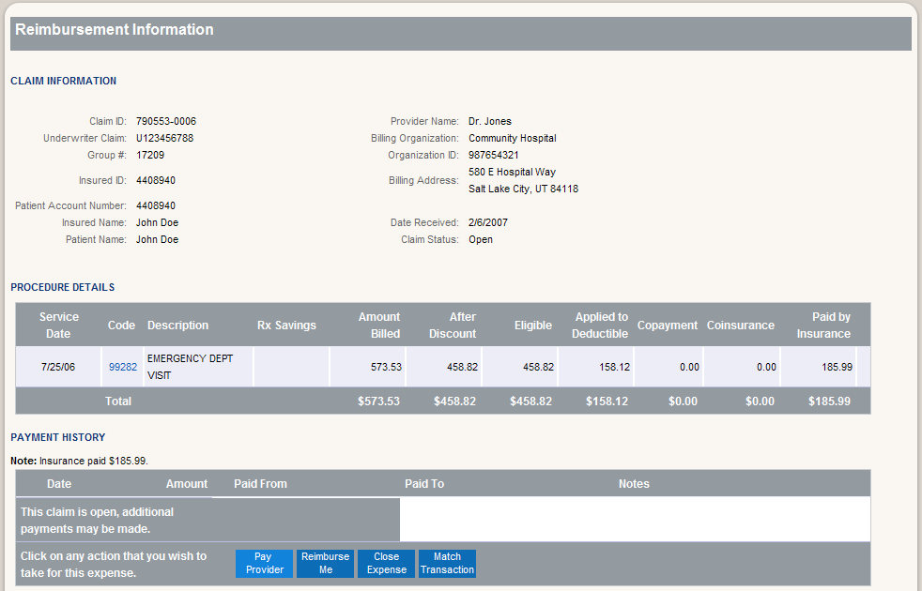
Prepopulated With Your Claims
Notes:
Here is an example of what a typical claim might look like.

Slide 15

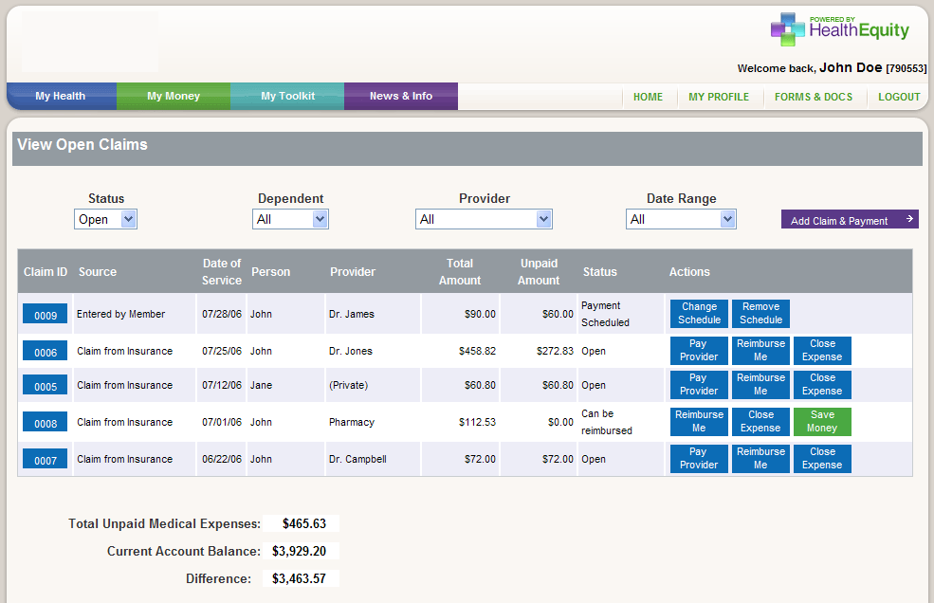
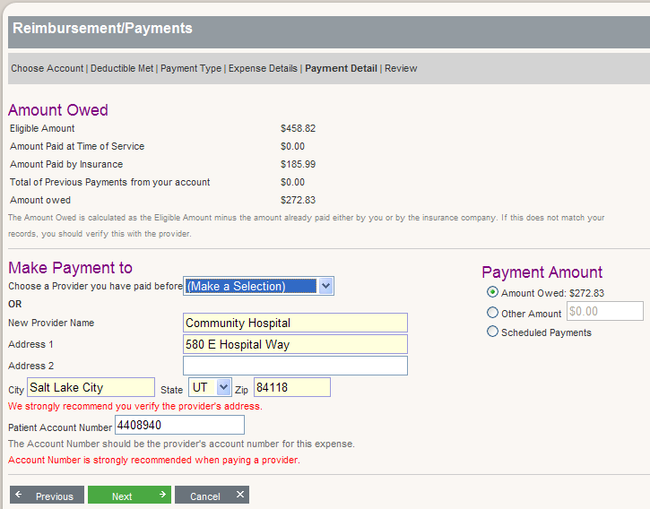
View and Pay Claims Online
Notes:
We are integrated with your insurance. What this means to you is that we will receive you claims or explanation of benefits directly from your insurance. These are not bills and are available to your online for your record keeping and convenience. You are given the option to pay a provider, reimburse yourself, or close your claim for online filling.

Slide 16
USING AN HSA

Slide 17

HSA How To
Doctors Visits
1
Go to the doctor
Doctor sends insurance carrier the bill
Claim integrated
into member portal
No co-pays
HealthAmerica adjusts price based on discounts
Pay doctor from HSA funds. Pay out of pocket (if funds aren’t available and reimburse yourself later).
2
3
*This card is issued by The Bancorp Bank pursuant to a license from Visa U.S.A. Inc. The Bancorp Bank; Member FDIC.

Slide 18






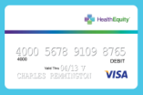



Member HSA Experience
Integrated Medical Claims
If deductible has not been met, provider will bill member for their plan negotiated portion.
Member goes
to Doctor, shows HealthAmerica card
Member pays outstanding provider bill using funds on HSA card or personal funds through member portal
When the member has claim activity,
an EOB from HealthAmerica is sent for each claim. Claim information and monthly statements on HSA funds and account information is available on HealthEquity portal.
If deductible has been met, plan will pay provider for service. If member owes coinsurance, provider will bill member for their portion.
daily
daily
HealthAmerica sends claims to HealthEquity for record keeping and member portal population
Doctor sends visit details and coding to HealthAmerica
for claims adjudication
daily

Slide 19
HSA How To
Pharmacy Prescriptions
1
Go to pharmacy
Pharmacy
applies discount
Pharmacy sends claim to insurance carrier
Show your HealthAmerica card
Pay with your
HSA card or
out of pocket
Insurance carrier applies
amount to your deductible—
no paperwork needed
2
3
*This card is issued by The Bancorp Bank pursuant to a license from Visa U.S.A. Inc. The Bancorp Bank; Member FDIC.

Slide 20




HSA Member Experience
Pharmacy Claims
Member goes to Pharmacy and shows HealthAmerica card
daily
When the member has claim activity, they will receive an EOB from HealthAmerica for each claim. Claim information and monthly statements on HRA funds and account information is available on each member’s HealthEquity portal.
Pharmacy and HSA card send payment information to Health America and HealthEquity for record keeping and account tracking.
daily
Pharmacy verifies eligibility.
If out of pocket max
is not met, member
can pay using HSA
card or out of pocket.
immediate

Slide 21
Member Services
HealthEquity Member Services is available everyday, 24/7/365 at
866.855.4066
Building Health SavingsSM through
Live Service 24/7/365
Personalized Savings Strategies
Account Integration

Slide 22
Questions?

